Slide 1
FRAGILIZATION, VETRINIZATION, MISINFORMation and platforming: new scenarios for educational processes
Francesco Pira Associate Professor- Department of Ancient and Modern Civilization

Slide 2
TECHNOLOGY AS RELATIONAL ENVIRONMENT
The dominant trend in the evolution of social relations within our societies is the rise of individualism, in all its manifestations. [...] From very different perspectives, social scientists such as Giddens, Putman, Wellman, Beck, Carnoy and myself have emphasized the emergence of a new system of social relations centered on the individual. After the transition from the predominance of primary relationships (represented by family and community) over secondary relationships (embodied in associations), the new dominant model seems to be built on what might be called tertiary relationships, or what Wellman calls "personalized communities," embodied on ego-centered networks. This represents the privatization of society [...] The new model of sociality is thus characterized by networked individualism (Castells 2002, pp 127-128).

Slide 3
Media as a space for symbolic negotiation
From mediatized society to informational society.

Slide 4
The paradox of the algorithm society
We are in the era of the platform society, an ecosystem run by the BIG FIVE (Apple, Microsoft, Google, Amazon, Meta)
4

Slide 5
Values vs. opaque dynamics
In the era of flatness and the filter bubble, platforms exploit that annihilation of boundaries that profoundly alters the ability on the part of individuals to understand context.

Slide 6
Typification of individuals
The process of dematerializing and typifying individuals as unique and unrepeatable entities can begin to erode our sense of personal identity as well. The risk is to start behaving and representing ourselves as anonymous mass products, exposed online to billions of other similar individuals. And to conceive of every other person as a bundle of types, from gender to religion, from family role to job position, from education to social class. (Floridi)

Slide 7
OLD DEFINITIONS NEW DEFINITIONS
The age of artificial intelligence has undone the definitions that applied until recently, the separation of real and virtual, categories that no longer exist with the increasingly massive digitization of processes. It is no longer just a fusion of word, text and image.

Slide 8
GLOBALIZATION OF THE ECONOMY AND THE SHATTERING OF SOCIETY
We have moved from the dimension of consumption to that of consumerism, which has turned individuals into commodities themselves.

Slide 9
SHATTERING OF REALITY
One of the most critical aspects emerging in the digital society concerns the juxtaposition between globalization of the economy and the shattering of society as a result, as Bauman argues in the volume Consumption therefore I am, we have moved from the dimension of consumption to that of consumerism that has turned individuals into commodities themselves.

Slide 10
THE CONNECTED PUBLICS
On social, it only takes a few clicks to express our thoughts in a post, comment or on our personal status, and we can also make use of images to do so.

Slide 11
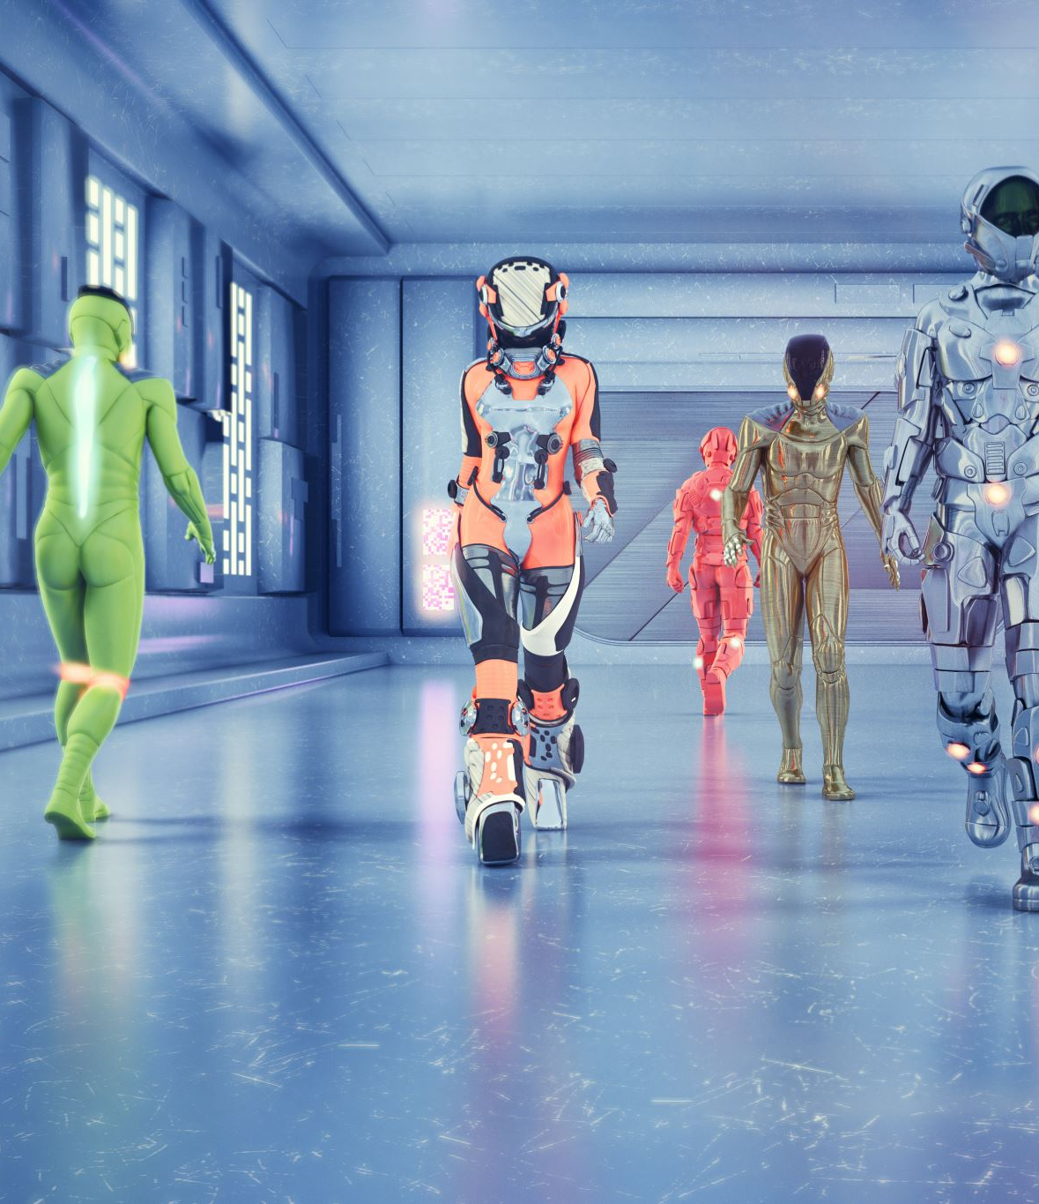
controllocracy
All connected and increasingly alone.
We do not yet know what price will be paid for this science fiction movie turned pure reality in terms of "controlocracy" and social relations.

Slide 12
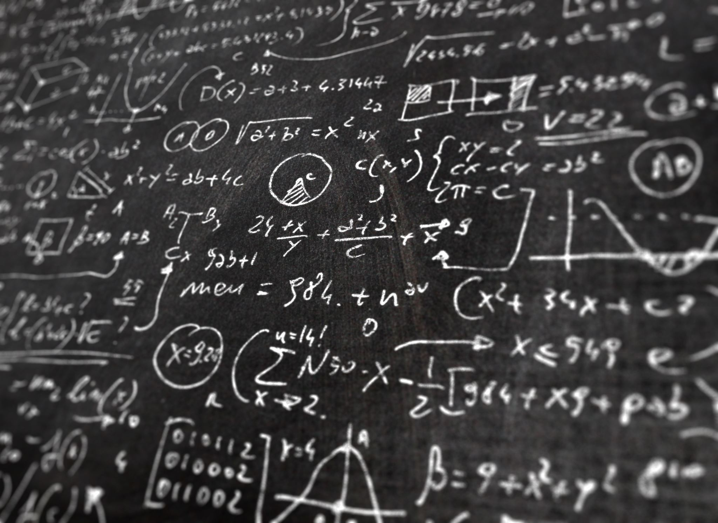
CRITICAL DIMENSIONS OF THE DIGITAL SOCIETY
Human experience is subjugated to the market mechanisms of capitalism, and reborn as "behavior." (Zuboff)

Slide 13
THE POWER OF DATA CREATES NETWORKS OF INFLUENCE
Han argues that a new value nihilism is spreading as a consequence of the crisis of truth losing its role as the regulator of truth itself. He goes so far as to point to nihilism as the very symptom of the information society.

Slide 14
AI…A DEFINITION
It is the world that is adapting to AI and not vice versa. [...] AI cannot be reduced to a "science of nature" or a "science of culture" (Ganascia, 2010) because it is a "science of the artificial," as Herbert Simon (1996) put it. As such, AI pursues an approach to the world that is neither descriptive nor prescriptive: rather, it investigates the constraining conditions that make it possible to construct and incorporate artifacts into the world that are capable of successfully interacting with it. In other words, it inscribes the world. [...] The world is becoming an infosphere better and better adapted to the bounded capabilities of AI.
(Floridi, 2022)

Slide 15
IA THREATS AND BEST PRACTICES
We are still at an embryonic stage of AI development, but the highly interdisciplinary nature it involves is already clear:
Science
Sociology
Psychology
Law
Economics

Slide 16
Technology and education
In 1997 I began to study the interactions between children, adolescents and new technologies and the evolution of these communicative dynamics related to the development of new media and technological platforms . In this course of investigation I observed how over time the technologization of society has had a profound impact on educational agencies, family and school in primis.

Slide 17
The division of learning
Controlling technology giving rise to surveillance capitalism introduces us into the concept of shadow text that influences the dynamics through which learning develops.
Zuboff (2019)

Slide 18
Identikit of a generation
In the latest research I conducted on a sample of 1858 junior high and high school girls and boys, surveyed through an online questionnaire, during the lockdown months of 2020.
The most critical elements that emerged include:
the tendency toward isolation
the strong propensity to window dressing in their lives
the hyper-connectedness
an obvious distorted use of technology through the use of fake profiles that create opacity and often trigger polarizing and violent behavior.

Slide 19
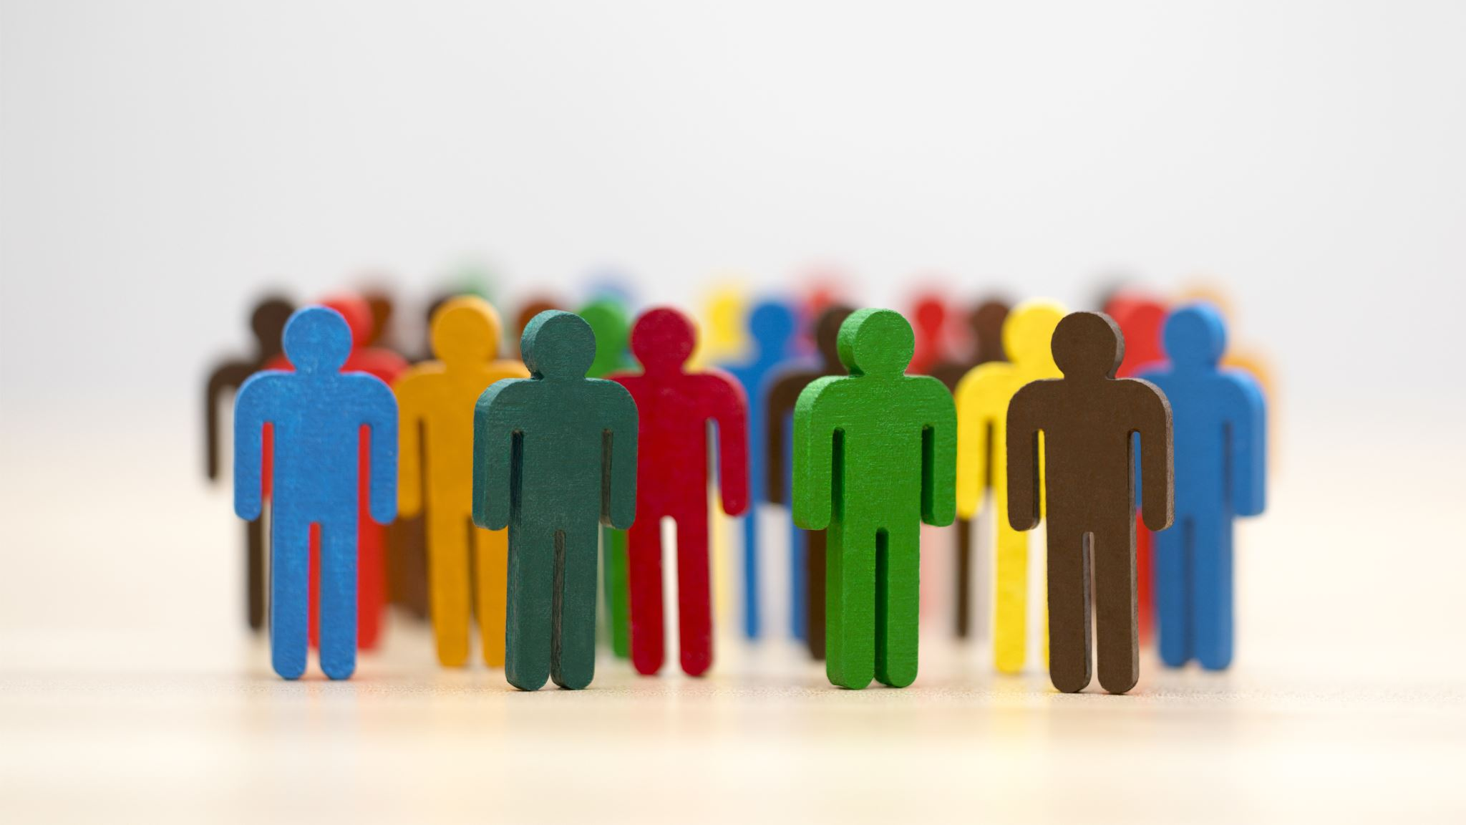
EDUCATING ON EMOTIONS
The risk of cultural impoverishment may generate EMOTIONAL ANALPHABETISM.
19

Slide 20
ETICS AND AI
The way in which "artifacts that are embedded in the world" are designed can give rise to dimensions that constitute threats and foster criminal behaviors with entirely different impacts than we are able to understand today, but it can also become an extraordinary opportunity if through a Governance of Digital we are able to bring to life what Floridi calls AI FOR SOCIAL GOOD - AI4SG
(Floridi, 2022, p. 221).

Slide 21
Fragility of educational processes
Adolescents appear as a "product" of this era of misinformation: victims of the fake news system, they become its protagonists by deeming it "normal" to use the fake for their own purposes (Pira 2020, p. 82).

Slide 22
FOOD FOR THOUGHT
Does the fluidity, contamination and communication developed through codes and texts that are often the result of the action of social sharing give rise to a message in which it is possible to recognize the mens autoris, or rather are we witnessing the proliferation of messages and language that is no longer an autonomous construction of meaning, but the effect of cloning that tends to massify?

Slide 23
Information alone does not explain the world. From a certain critical point, it obscures the world. We always approach information with the suspicion that things might also be different. It is accompanied by an underlying distrust. The more we confront diverse information, the stronger the distrust becomes. In the information society, we lose basic trust: it is a society of distrust.
(Han, 2021: 69)

Slide 24
THANK YOU FOR YOUR ATTENTION
Francesco Pira
Associate Professor of Sociology of Cultural and Communicative Processes
Department of Ancient and Modern Civilizations
University of Messina
Francesco.pira@unime.it

